Slide 1
PROBABILITY & STATISTICS
Chapter 6: Random sampling & Data Description
(Mẫu ngẫu nhiên và Mô tả dữ liệu)
Learning objectives
Introduction to Statistics
Frequency distributions and histograms
Numerical distribution: measures of central tendency, measures of variation, measures of position.
Probability plots

Slide 2




WHAT IS DATA
Introduction
What is data
Consist of information coming from observations, counts, measurements, or responses.
Type of data
Qualitative Data
Quantitative data
Age
Temperature
Major
Place of birth

Slide 3
WHAT IS STATISTICS
Introduction
What is Statistics
The science of collecting, organizing, analyzing, and interpreting data in order to make decisions.
Descriptive Statistics:
Involves organizing, summarizing, and displaying data.
e.g. Tables, charts, averages
Inferential Statistics Involves using sample data to draw conclusions about a population.

Slide 4
DATA COLLECTION: THE BASIC METHODS
Introduction
(1) Retrospective (hồi quy) study using historical data
(2) Observational study (quan sát)
A researcher observes (quan sát) and measures (đo lường) characteristics of interest of part of a population.
(3) Experiment (thực nghiệm)
A treatment is applied to part of a population and responses are observed.

Slide 5
DATA COLLECTION: THE BASIC METHODS
Introduction
(4) Simulation (mô phỏng)
(a) Uses a mathematical or physical model to reproduce the conditions of a situation or process.
(b) Often involves the use of computers.
(5) Survey (khảo sát)
(a) An investigation of one or more characteristics of a population.
(b) Commonly done by interview, mail, or telephone.

Slide 6
FREQUENCY DISTRIBUTION
Frequency Distribution (Phân phối tần suất)
Frequency distribution
(1) The frequency distribution is a summary table in which the data are arranged into numerically ordered class groupings.
(2) You must give attention to selecting the appropriate number of class groupings for the table, determining a suitable width of a class grouping, and establishing the boundaries of each class grouping to avoid overlapping.
(3) To determine the width of a class interval, you divide the range (Highest value–Lowest value) of the data by the number of class groupings desired.

Slide 7
FREQUENCY DISTRIBUTION
Example
Frequency distribution
A manufacturer of insulation randomly (VL cách nhiệt) selects 20 winter days and records the daily high temperature
24, 35, 17, 21, 24, 37, 26, 46, 58, 30, 32, 13, 12, 38, 41, 43, 44, 27, 53, 27
Class | Frequency | Relative Frequency
[10, 20) | 3 | 0.15
[20, 30) | 6 | 0.30
[30, 40) | 5 | 0.25
[40, 50) | 4 | 0.20
[50, 60) | 2 | 0.10
Total | 20 | 1.00

Slide 8
FREQUENCY DISTRIBUTION
Histogram (Biểu đồ)
Frequency distribution
(1) A graph of the data in a frequency distribution is called a histogram.
(2) The class boundaries (or class midpoints) are shown on the horizontal axis (trục hoành).
(3) The vertical axis is either frequency, relative frequency, or percentage.
(4) Bars of the appropriate heights are used to represent the number of observations within each class.

Slide 9
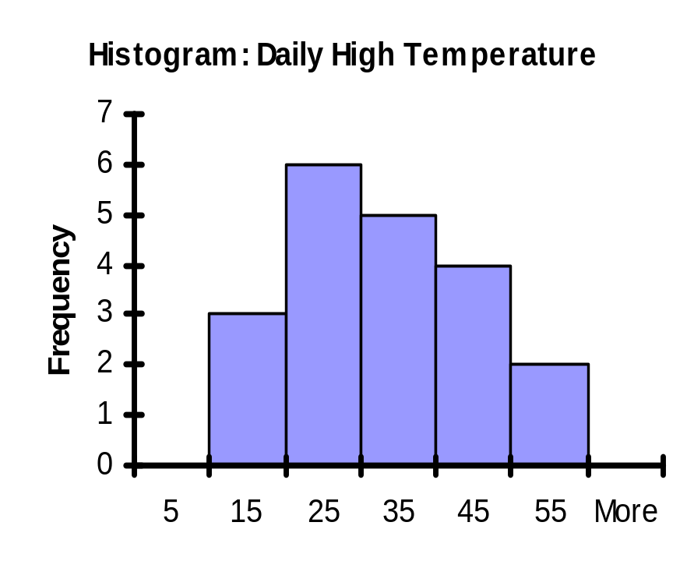
FREQUENCY DISTRIBUTION
Class | Frequency | Relative Frequency
[10, 20) | 3 | 0.15
[20, 30) | 6 | 0.30
[30, 40) | 5 | 0.25
[40, 50) | 4 | 0.20
[50, 60) | 2 | 0.10
Total | 20 | 1.00
Frequency distribution

Slide 10
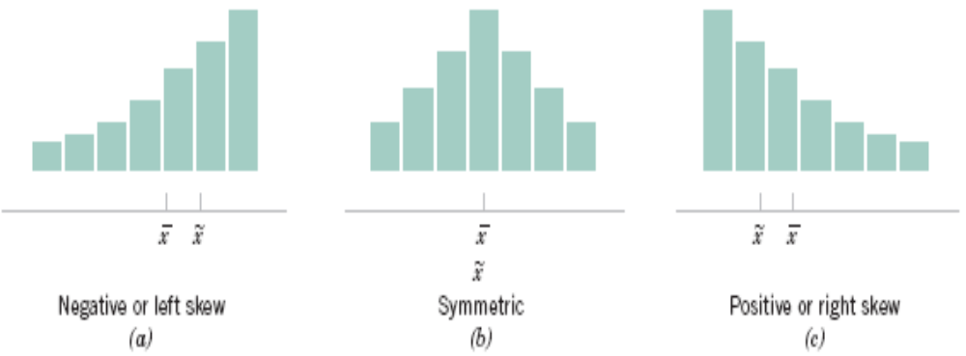
COMMON DISTRIBUTION SHAPES
Frequency distribution
Figure 6-11 Histograms for symmetric and skewed distributions.

Slide 11
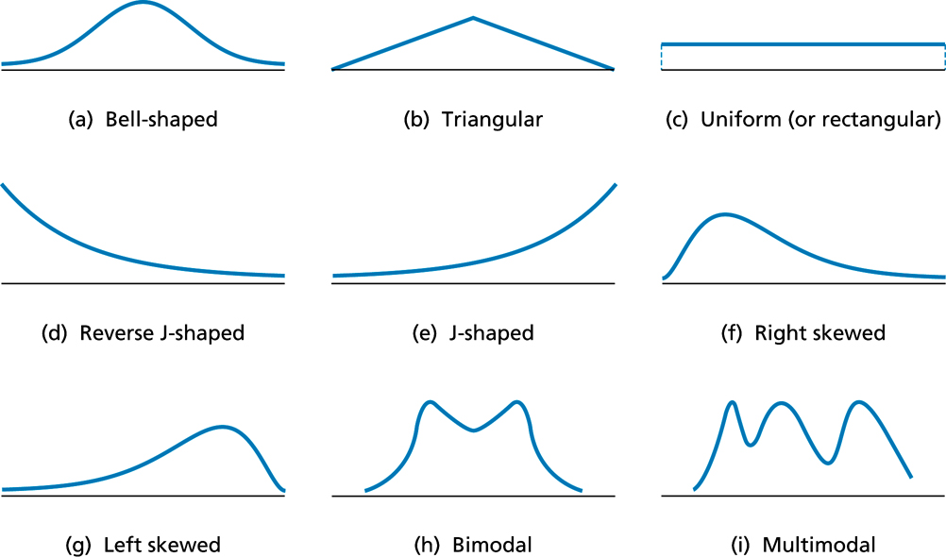
COMMON DISTRIBUTION SHAPES
Frequency distribution

Slide 12
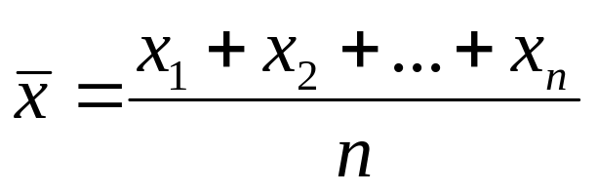
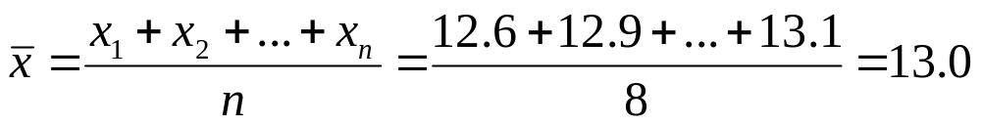
MEASURES OF CENTRAL TENDENCY
Sample mean (TB Mẫu)
If the n observations in a sample are denoted by x₁, x₂, …, x_{n}, the sample mean is
Numerical Summaries
Example
Let’s consider the weight of the eight observations collected from the prototype engine connectors: 12.6, 12.9, 13.4, 12.3, 13.6, 13.5, 12.6 and 13.1

Slide 13
MEASURES OF CENTRAL TENDENCY
Sample median (Trung vị mẫu)
(1) The value that lies in the middle of the data when the data set is ordered.
(2) Measures the center of an ordered data set by dividing it into two equal parts.
(3) If the data set has an
(a) even number of entries: median is the mean of the two middle data entries.
(b) odd number of entries: median is the middle data entry.
Numerical Summaries

Slide 14
MEASURES OF CENTRAL TENDENCY
Example
The prices (in dollars) for a sample of roundtrip flights from Chicago, Illinois to Cancun, Mexico are listed. Find the median (trung vị) of the flight prices.
872 432 397 427 388 782 397
Numerical Summaries
First order the data.
  388 397 397 427 432 782 872
The median price of the flights is $427.

Slide 15
MEASURES OF CENTRAL TENDENCY
Sample mode (số mode)
(1) The data entry that occurs with the greatest frequency.
(2) If no entry is repeated the data set has no mode.
(3) If two entries occur with the same greatest frequency, each entry is a mode (bimodal).
Numerical Summaries
Example
At a political debate a sample of audience members was asked to name the political party to which they belong. Their responses are shown in the table. What is the mode of the responses?

Slide 16
MEASURES OF CENTRAL TENDENCY
Political Party | Frequency, f
Democrat | 34
Republican | 56
Other | 21
Did not respond | 9
Numerical Summaries
The mode is Republican (the response occurring with the greatest frequency). In this sample there were more Republicans than people of any other single affiliation.

Slide 17
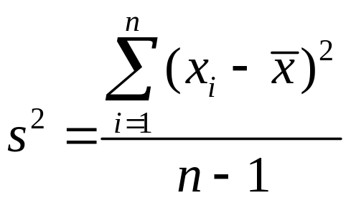
MEASURES OF VARIATION
Sample Variance and sample standard deviation
(1) If x₁, x₂, … , x_{n}, is a sample of n observations, the sample variance is
(2) The sample standard deviation, s, is the positive square root of the sample variance.
Numerical Summaries

Slide 18
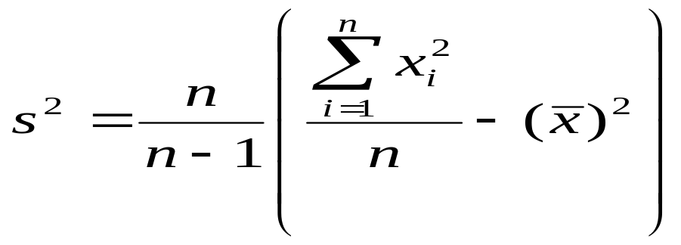
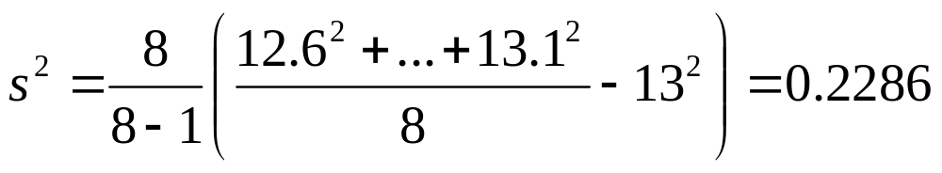

MEASURES OF VARIATION
Computing formula for σ²
Numerical Summaries
Let us return to the Example in page of this slide.
Sample Variance
Sample standard deviation

Slide 19
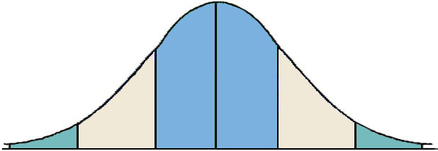
MEASURES OF VARIATION
Interpreting standard deviation: For data with a bell-shaped distribution
99.7% within 3 standard deviations
Numerical Summaries
95% within 2 standard deviations
68% within 1 standard deviation
34%
34%
2.35%
2.35%
13.5%
13.5%

Slide 20
MEASURES OF VARIATION
Sample range
The difference between the maximum and minimum data entries in the set.
The data must be quantitative.
If the n observations in a sample are denoted by x₁, x₂, … , x_{n}, the sample range is
Numerical Summaries
r = max(x_{i}) – min(x_{i})

Slide 21
MEASURES OF POSITION: QUARTILES
(1) Fractiles are numbers that partition (divide) an ordered data set into equal parts.
(2) Quartiles approximately divide an ordered data set into four equal parts.
  (a) First quartile, Q1: About one quarter of the data fall on or below Q1.
  (b) Second quartile, Q2: About one half of the data fall on or below Q2 (median).
  (c) Third quartile, Q3: About three quarters of the data fall on or below Q3.
Numerical Summaries

Slide 22
MEASURES OF POSITION: QUARTILES
Example
The test scores of 15 employees enrolled in a CPR training course are listed. Find the first, second, and third quartiles of the test scores.
13 9 18 15 14 21 7 10 11 20 5 18 37 16 17
Numerical Summaries
Q₂ divides the data set into two halves.
Lower half
Upper half
5 7 9 10 11 13 14 15 16 17 18 18 20 21 37
Q₂

Slide 23
MEASURES OF POSITION: QUARTILES
The first and third quartiles are the medians of the lower and upper halves of the data set.
Lower half
Upper half
Numerical Summaries
5 7 9 10 11 13 14 15 16 17 18 18 20 21 37
Q₁
Q₂
Q₃
About one fourth of the employees scored 10 or less, about one half scored 15 or less; and about three fourths scored 18 or less.

Slide 24
PROBABILITY PLOTS
Probability Plots
(1) Probability plotting is a graphical method for determining whether sample data conform to a hypothesized distribution based on a subjective visual examination of the data.
(2) Probability plotting typically uses special graph paper, known as probability paper, that has been designed for the hypothesized distribution. Probability paper is widely available for the normal, lognormal, Weibull, and various chi-square and gamma distributions.
Probability
Plots

Slide 25
PROBABILITY PLOTS
Example
Ten observations on the effective service life in minutes of batteries used in a portable personal computer are as follows:
176, 191, 214, 220, 205, 192, 201, 190, 183, 185.
We hypothesize that battery life is adequately modeled by a normal distribution. To use probability plotting to investigate this hypothesis, first arrange the observations in ascending order and calculate their cumulative frequencies (j-0.5)/10 as shown in Table 6-6.
Probability
Plots

Slide 26
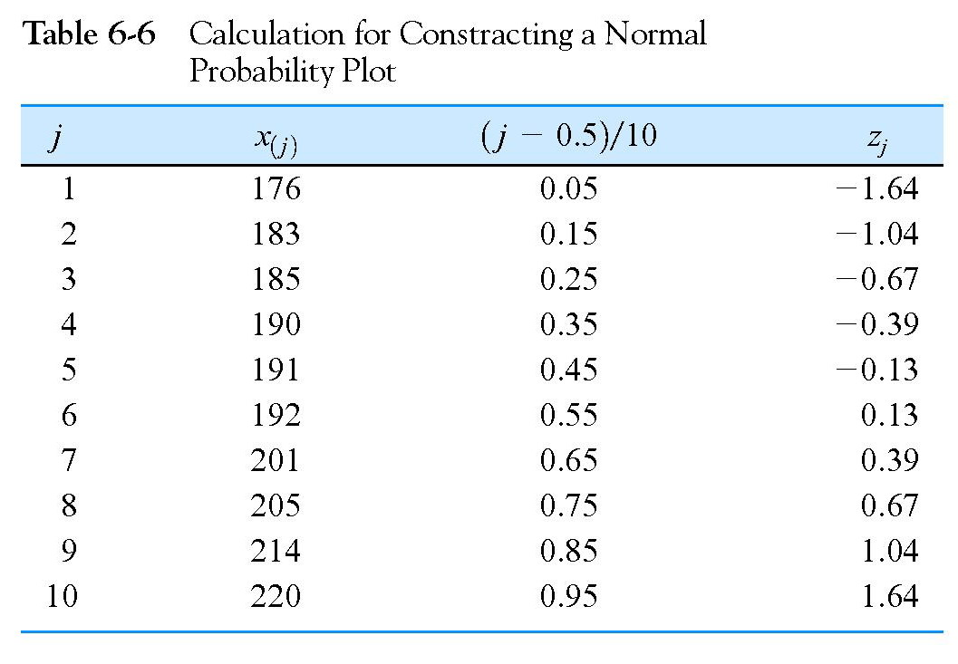
PROBABILITY PLOTS
Probability
Plots

Slide 27
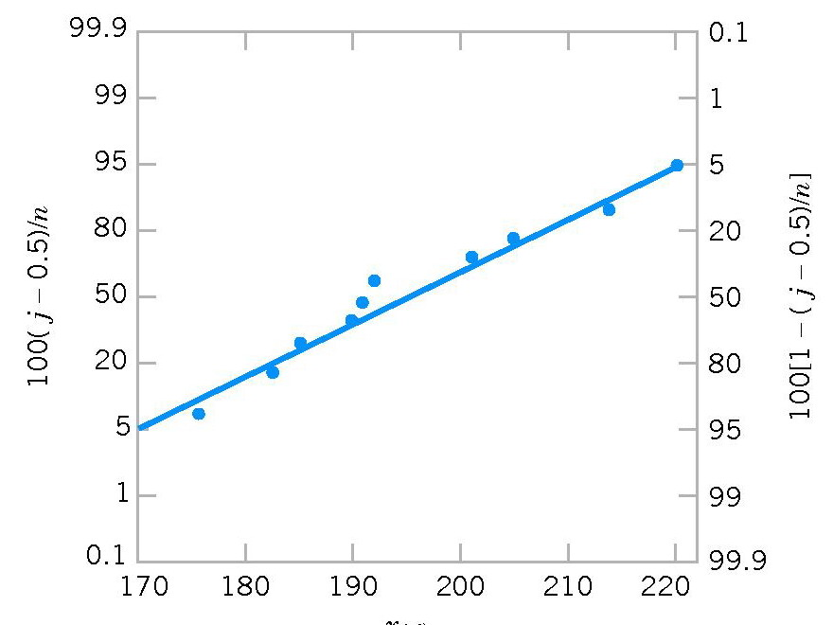
PROBABILITY PLOTS
Probability
Plots
Figure 6-19 Normal probability plot for battery life.

Slide 28
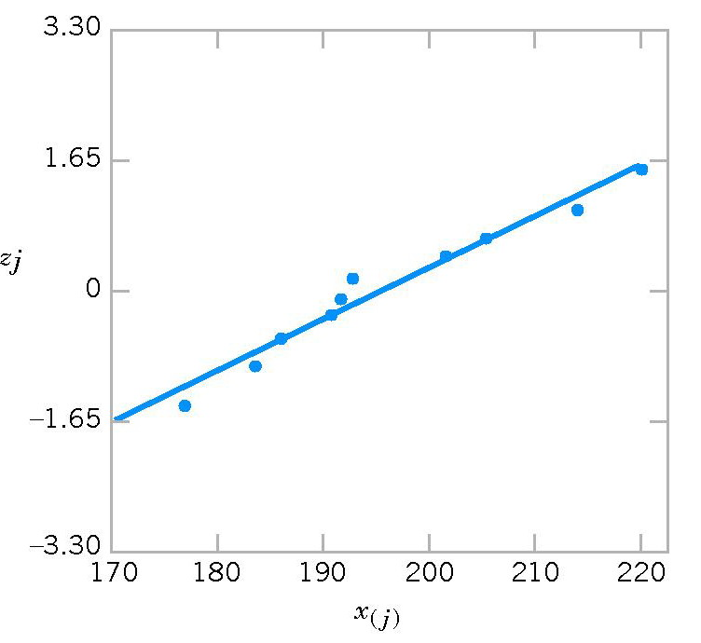
PROBABILITY PLOTS
Probability
Plots
Figure 6-20 Normal probability plot obtained from standardized normal scores.

Slide 29
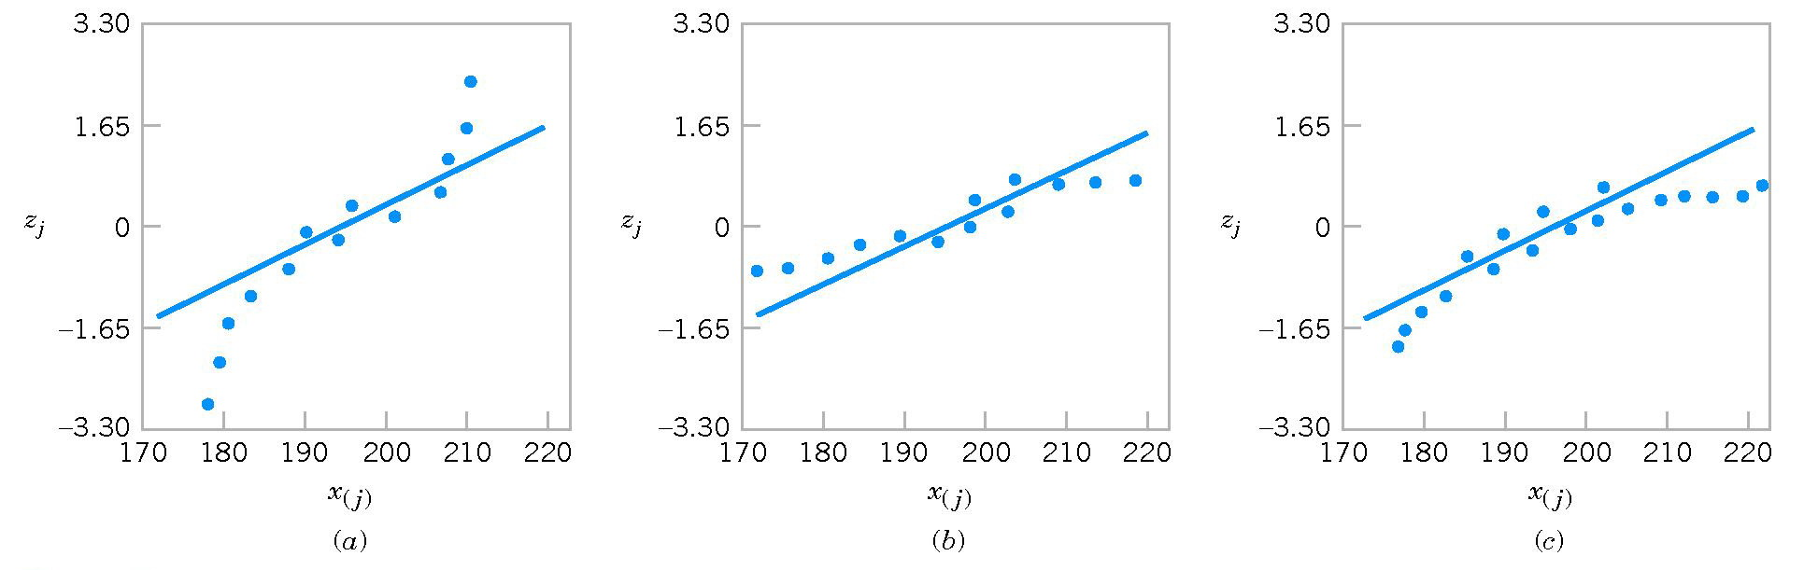
PROBABILITY PLOTS
Probability
Plots
Figure 6-21 Normal probability plots indicating a non- normal distribution. (a) Light-tailed distribution. (b) Heavy-tailed distribution. (c ) A distribution with positive (or right) skew.

Slide 30
SUMMARY
In this chapter, we studied
Introduction to Statistics
Frequency distributions and histograms
Numerical distribution: measures of central tendency, measures of variation, measures of position.
Probability plots
Summary
Homework: Read slides of the next lecture.

